Slide 1


MATTER OF LIFE
DOCTOR AI

Slide 2

INTRODUCTION
Imagine having a personal doctor available to you 24/7, ready to assist with your health concerns, prescribe medications, and even provide real-time consultations.
Doctor AI an app which can assist with your health concerns , prescribing medications and also provides real-time consultations.

Slide 3



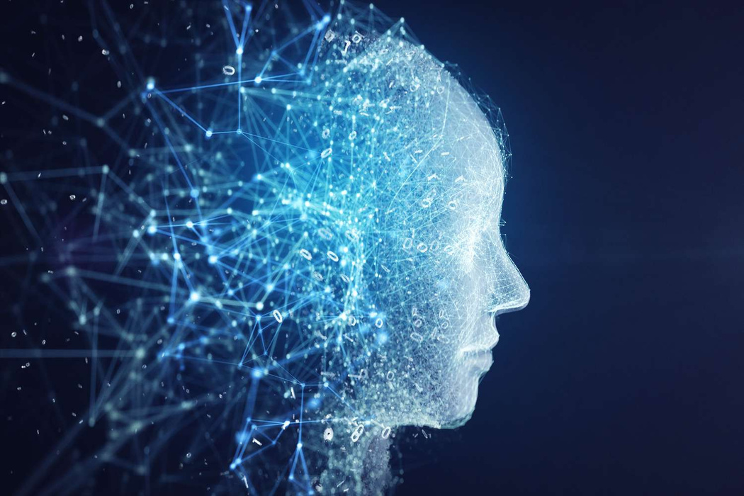
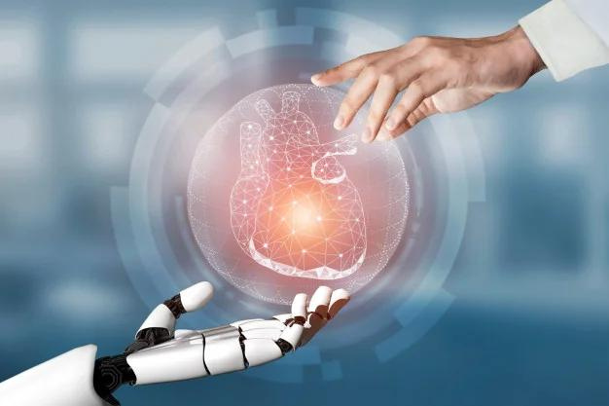


DOCTOR AI MAKES THIS POSSIBLE THROUGH ITS ADVANCED AI-POWERED CHATBOT. THIS CHATBOT IS DESIGNED TO EMULATE THE INTERACTION YOU WOULD HAVE WITH A REAL DOCTOR.
IT PROVIDES A TAILORED RESPONSE AND RECOMMEND APPROPRIATE MEDICATIONS.

Slide 4
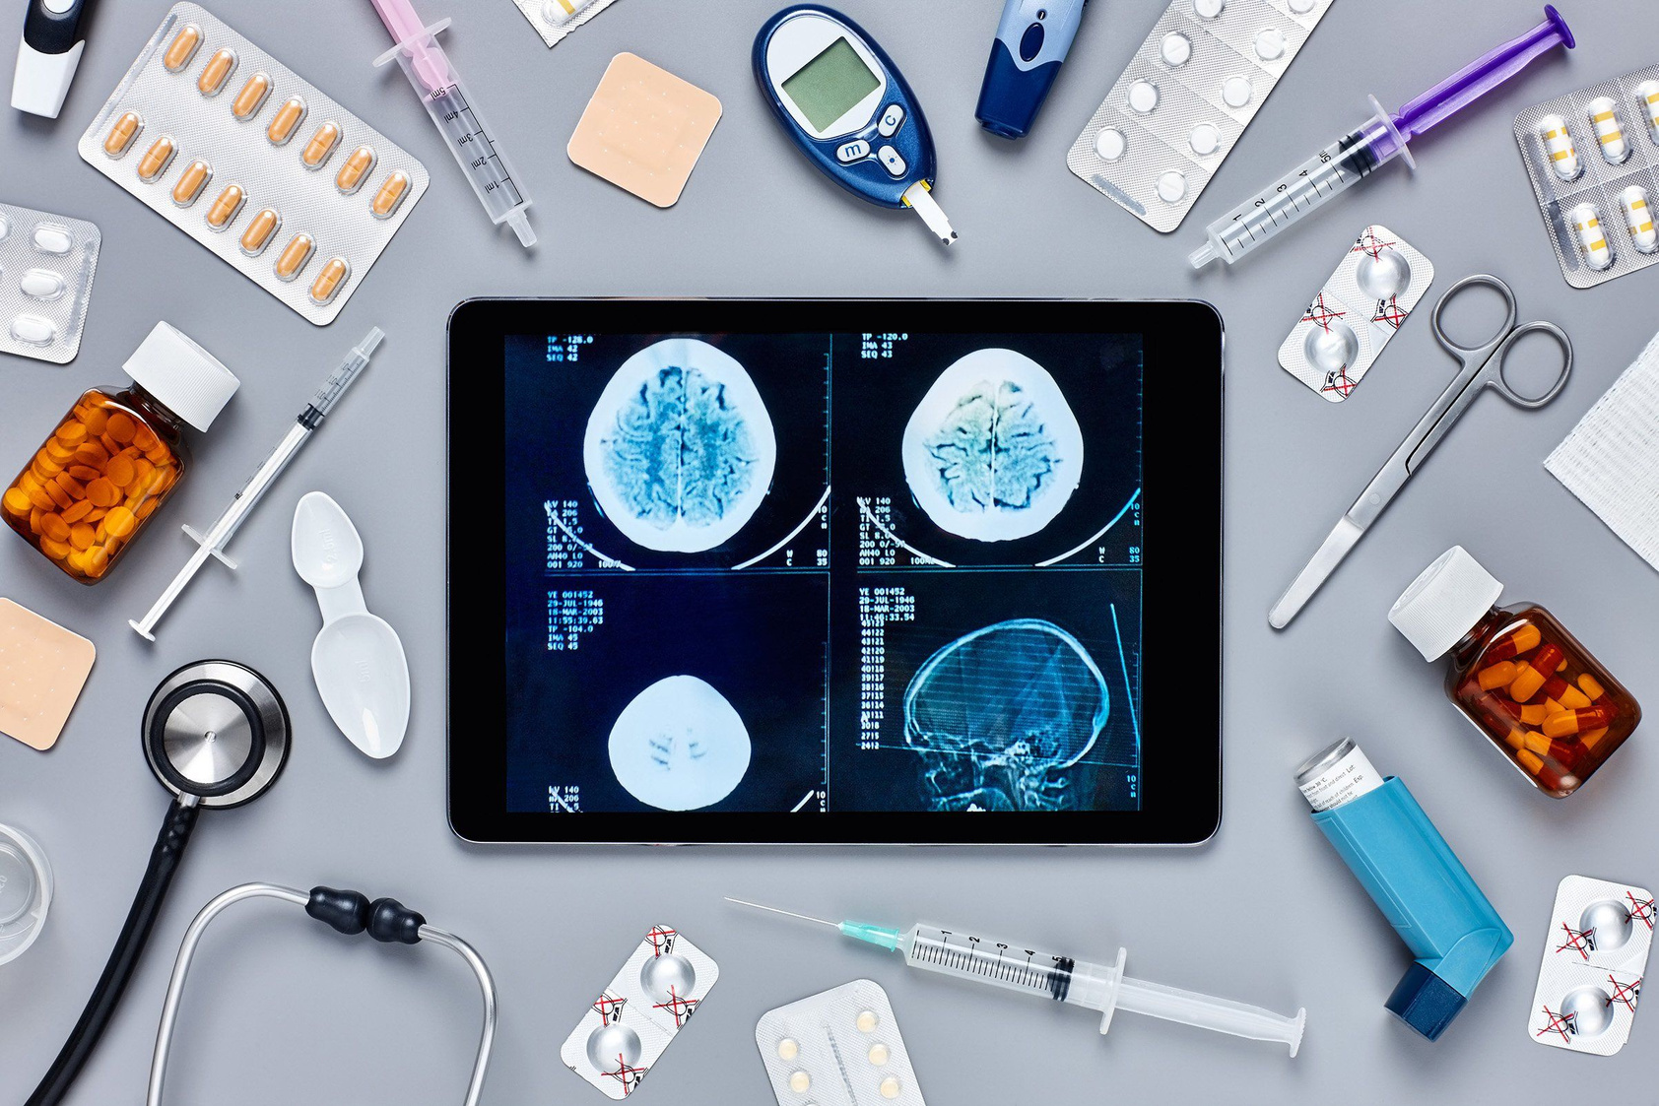
(1) But Doctor AI doesn't stop there. We have incorporated a cutting-edge scanning feature that uses AI to analyze your body parts and generate detailed reports, eliminating the need for an initial doctor's visit. If the AI detects any signs of a serious condition, it will immediately advise you to seek professional medical attention.
(2) In addition, Health AI offers live doctor consultations. Whenever you feel the need to speak with a healthcare professional, this app facilitates real-time communication, ensuring you get the medical advice you need without any delays.

Slide 5


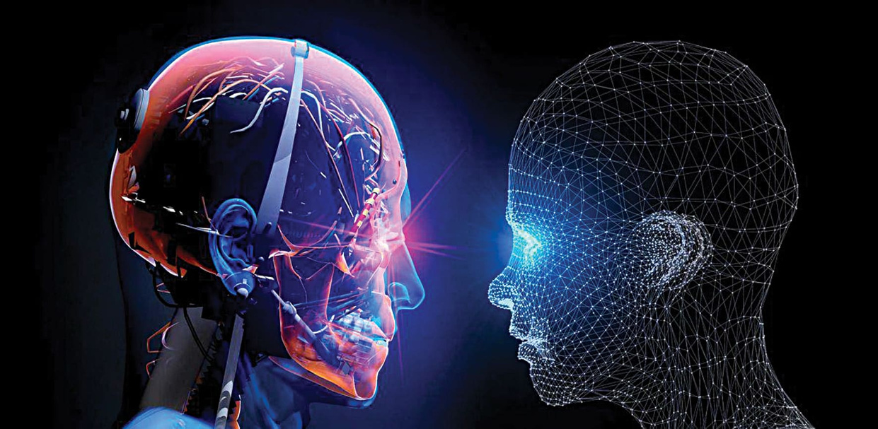

WE UNDERSTAND THAT EMERGENCIES CAN HAPPEN AT ANY TIME, AND BEING PREPARED IS CRUCIAL. THAT'S WHY DOCTOR AI INCLUDES A COMPREHENSIVE DIRECTORY OF HOSPITAL LOCATIONS AND DOCTOR PROFILES. IN CASE OF AN EMERGENCY, YOU'LL KNOW EXACTLY WHERE TO GO AND WHOM TO CONTACT.
Doctor AI also empowers you with the knowledge and tools to take control of your own health care. It gives guidance to treat your own like taking injections, performing first aid, or simply managing everyday health needs or fitness needs .
You can order medications and health products directly through the app, making it as convenient as shopping on Amazon. Our delivery service ensures you receive your medicines promptly, no matter where you are.

Slide 6
FEATURES IN APP
1
2
3
4
5
Chat with AI Bot without
doctor consultation
Online marketing Facility
Storing the Medical Reports
Quick Online
Consultation with doctor
Scanning facilities in future updates

Slide 7

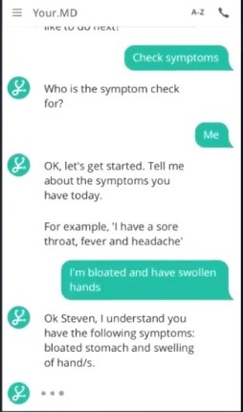
AI Chat Bot
Doctor AI's chatbot interacts like a real doctor. It gathers your age, gender, blood group, and other details to provide tailored responses and recommend appropriate medications for symptoms like fever.

Slide 8
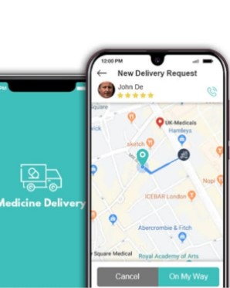
Ordering Medicines through Online
The app allows users to order medicines online, providing a convenient and efficient way to access healthcare products. Users can browse a wide range of medications, upload prescriptions, and have their orders delivered to their doorstep. It ensures secure transactions and maintains user privacy. Additionally, the app may offer features like prescription refills, dosage reminders, and professional consultations.

Slide 9
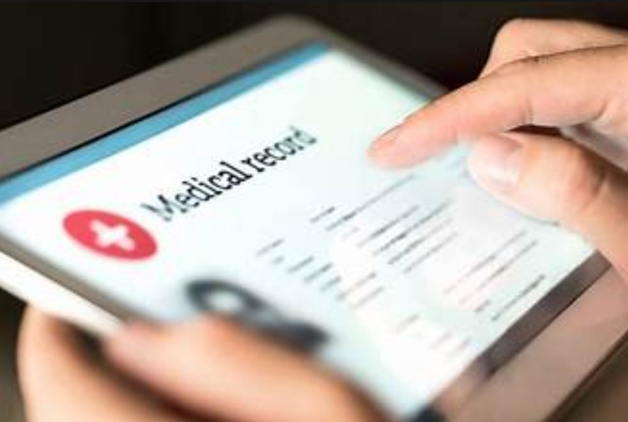
Storing The Medical Reports
The app includes a health reports storage facility, enabling users to securely upload and store their medical documents and test results. This feature ensures easy access and management of health records from any location. Users can share their reports with healthcare providers directly through the app. The storage is encrypted, maintaining the confidentiality and privacy of sensitive health information.

Slide 10
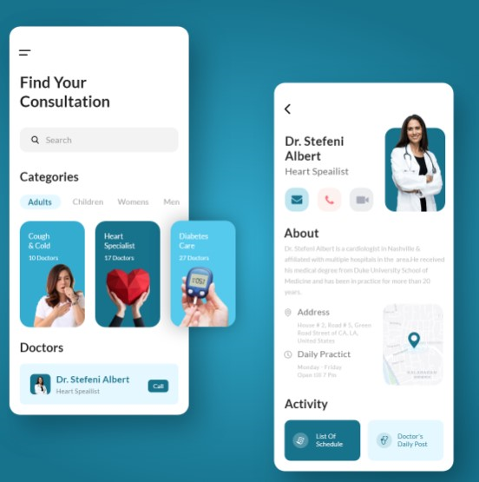
Online Doctor Consultation
The app includes an online doctor consultation feature, enabling users to connect with healthcare professionals from the comfort of their homes. Users can schedule virtual appointments, discuss their health concerns, and receive medical advice and prescriptions. This service ensures timely access to medical expertise and enhances overall healthcare convenience. The consultations are secure and maintain patient confidentiality.

Slide 11
Machine Learning
ML Algorithms prescribe appropriate medications
Possible Medical Conditions
ML models
Considering user’s specific factors
Trains models on large datasets of symptoms and diagnosis

Slide 12
Required tools
For Chatbot :
1) National Language Toolkit (NLTK)
2) Spacy
3) TensorFlow with with keras
4) Dialog flow or Rasa for conversational AI
Symptom Analysis and Prescription :
1) Scikit-learn for building classification models
2) TensorFlow or Pytorch
3) Flask or Django for API development
Real-time Doctor Consultations:
1) WebRTC for real-time communication
2) Flask or Django for backend development
3) React or Angular for frontend development
Emergency Assistance and Hospital Directory:
1) Google Maps API for location services
2) Django or Flask for backend development

Slide 13
Medication Ordering and Delivery :
1) Payment gateways like Stripe or PayPal for transactions
2) Django or Flask for backend development
3) React Native or Flutter for mobile app development
Image Processing and Scanning :
1) OpenCV for image processing
2) TensorFlow or Pytorch for deep learning-based image analysis
3) Flask or Django for API development

Slide 14

THANK YOU

